Slide 1
Women, WASH and Health in Rural Pune District Identifying stress and unmet needs
Pallavi Lele
KEM Hospital Research Centre
Pune, India
Sanitation and Women in India: Research Findings
Habitat Centre,Delhi, India
7-8 November 2014

Slide 2
Too few toilets for too many people
Indicated failure to apply expertise
Household coverage with cell phones 59% compared with 47% with toilets (Census 2011)
Many schools fail to comply with requirements for toilets
Medical facilities lack adequate sanitation facilities
Mars landing: contradiction between high-tech capacity and limited attention to basic needs, incl. sanitation

Slide 3
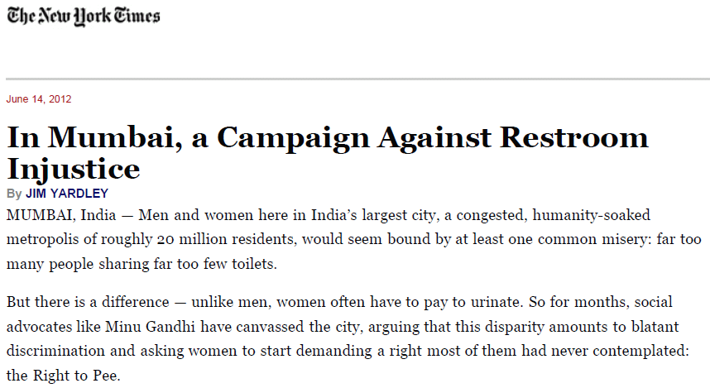
Well-known and widely reported

Slide 4
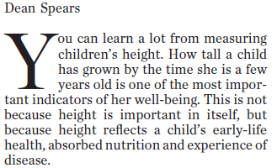
The Hindu, Chennai,
14 Mar 2013.
See also,
Chambers R and von Medeazza G. Sanitation and stunting in India: undernutrition’s blind spot. Econ Pol Weekly 22 Jun 2013.

Slide 5
Health and Gender-related impact
Health
Diarrheal diseases
Stunting
Psychosocial stress from limited (access to) facilities
Gender-related
Vulnerability to violence and victimization
Cultural meaning and social restrictions of menstruation
Burden of culturally mandated modesty

Slide 6
Coping
Problematic
Avoiding hydration and solid foods
Acceptance of unacceptable status quo
Constructive
Clarify the nature and extent of community-perceived burden
Challenge victim-blaming
Advocacy and support

Slide 7
Request for Proposals : The effects of poor sanitation on women and girls in India
Response
Collaboration between:
KEM Hospital Research Centre Pune’s field site Vadu Rural Health Program in India (KEMHRC)
and
Swiss Tropical and Public Health Institute, Basel, Switzerland (Swiss TPH)

Slide 8
Conceptual framework of research plan
Basic
needs
Defecation-urination
Nutrition-hydration
Facilities and resources
Toilets and fields
Water and food
Use-mitigating factors
Personal prior experience
Family and community experience and expectations
Menstruation
Absorbent materials
Social and cultural values
Practice
WASH-related behaviour
Indicated adjustments to dietary and fluid intake
Menstrual hygiene
Health impact
Self-perceived health problems or benefits of reported practice
Psychosocial effects: personal, family and community

Slide 9
Aims
Identify sources of psychosocial stress with reference to personal experience, reported accounts and perceived vulnerability to violence that affect access and use of various types of sanitation facilities and open defecation.
Identify women’s preferences, priorities, practices and perceived needs regarding menstrual hygiene, distinguishing preferred and available options, assessing the stress imposed by social expectations and cultural values and clarifying perceived effects on women’s health.
Assess the level of stress, priority and self-perceived effects of limited access to water and sanitary facilities, and the extent to which such concerns may lead to coping strategies that involve limiting intake of food and liquids.
Determine the availability, functionality and perceived adequacy of sanitary infrastructure in local health facilities, with particular attention to those facilities providing prenatal and obstetric care. Clarify whether these concerns influence the preference and use of accessible health facilities.

Slide 10
Methods
No. | Research Method | Sample
1. | Quantitative Research
 | Survey questionnaire | 150 adolescents (13-17 years) 150 adults (18-45 years)
 | Health facility infrastructure assessment | 12 health facilities in the study area (public as well as private)
2. | Qualitative Research
 | a. Focus group discussions | 8 to 12 Focus Group Discussions(2 each of adolescents, young women, older women and seasonal migrant women)
 | b. Key informant interview | 10 Key Informants Interview (2 each of Members of Gram Panchayat, Members of Panchayat Samiti, School Teachers, Health Professionals like ASHA, ANM and Medical officers).
 | c. Free listing | 20 adolescents (13-17 years) 20 adults (18-45 years)

Slide 11
Data analysis: qualitative
Collected through FGDs, KIIs and Free listing:
Transcription and translation of recordings
First-level coding
Analysis using standard qualitative analysis approaches and programmes (e.g. MAXQDA)
Analysis of the free listing exercise with reference to the cultural domains they refer to, including WASH-related and menstruation-related issues

Slide 12
Data analysis: quantitative
Collected through community survey and WASH infrastructure in health facilities survey
Verification of data integrity
Summarizing data with standard descriptive statistical measures such as means, median and standard deviations.
Statistically significant associations using standard statistical tests such as Pearson’s chi-square test and t-tests, as appropriate.
Multivariate models to identify the most important determinants of certain outcomes while considering known and suspected explanatory and confounding variables.
Using STATA statistical package

Slide 13
Work done so far
Site visit by Prof. Mitchell Weiss in July 2013,
Study Inception workshop in September 2013 to finalize the protocol and data collection tools,
Training of field team in end of November 2013,
Field data collection from 2nd December 2013 to February 2014,
Results meeting 7th to 9th May 2014.
Four publications – one accepted, one submitted, twp under preparation.

Slide 14
Findings 1: Psychosocial stress associated with toilet use
Open defecation: 9% of residents and most seasonal migrants
 | Latrines | Open defecation
Problems | 14% no water available | 46% unclean
 | 10% inadequate lighting | 42% no water available
 | 4% long waiting time | 23% unsafe feeling
 | 3% unclean | 19% long distance
Fears | 5% injury/snakes | 36% injury/snake
 | 2% abuse | 5% abuse
Stress | 6% lack of personal safety | 64% lack of personal safety
 | 3% lack of privacy | 44% lack of privacy
 | 5% lack of cleanliness | 46% lack of cleanliness

Slide 15
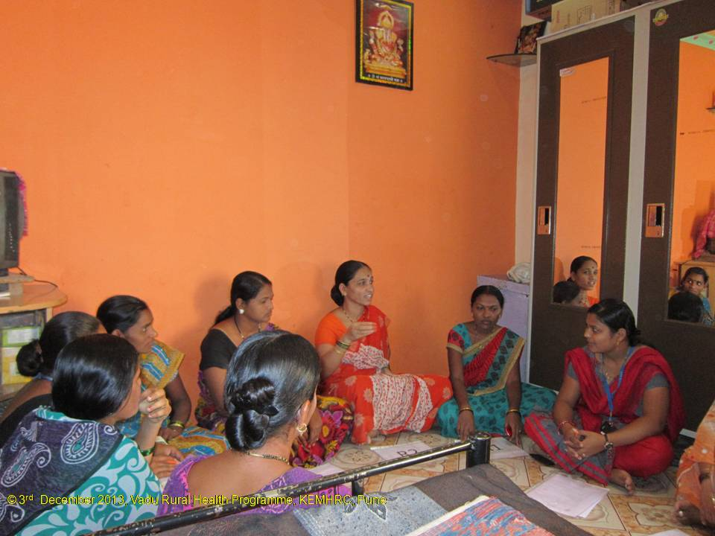
Findings 1: Psychosocial stress associated with toilet use
“In the summer season there are less problems than in the rainy season when going out in the open becomes difficult for women. We don’t feel like going there, it becomes very filthy”. A woman in a FGD
“They have the problem of finding an unfrequented place. Now there are no open spaces remaining as there were in the past which is a kind of hassle.” KII with health worker

Slide 16
Findings 1: Psychosocial stress associated with toilet use
Good Morning Committee
Lack of privacy is stressing in more situations than during act of defecation
Seasonal migrant women report stress from lack of privacy but not fear for personal safety or injury
Often insufficient latrines in market places, at bus stands etc. This can lead to stress and unhealthy coping (e.g. drinking less)
Self-reported stress

Slide 17
Findings 2: Coping strategies in response to limited sanitation facilities
Reported coping mostly related to non-routine situations (e.g. travel)
More likely to report coping if higher level stress is reported
Coping strategy (% of total) | Adolescents (n = 154) | Women (n = 154)
Delayed relief (19%) | 17% | 21%
Drinking less (8%) | 9% | 7%
Eating less (6%) | 5% | 6%
Combined (24%) | 22% | 27%
Medical problems due to coping (5%) | 7% | 3%

Slide 18
Findings 2: Coping strategies in response to limited sanitation facilities
“I have urine problem; if I drink water then I have to go for frequent urination in the night. So I drink less water.” Young woman in FGD
Some awareness for negative health effects of some coping mechanisms (e.g. drinking less, delaying relief)
Coping can result in stress – e.g. when going to the toilet in the dark due to shame then fear is the result

Slide 19
Findings 3: Availability and perceived adequacy of WASH infrastructure in health facilities
 | Public (n=6) | Private (n=6) | Total (n=12)
Adequacy (latrines) good Type Beds/latrines ratio Out-patients/latrines ratio | 4 3.5 34.0 | 6 4.1 6.7 | 10 3.9 14.0 | Flush toilets inside or outside One public facility without toilets One public facility without toilets
Adequacy (hand washing stations) good Type Beds/HWS ratio Out-patients/HWS ratio | 4 5.6 55.3 | 6 3.9 6.3 | 10 4.2 15.0 | Distance <10 m from latrine Two public facilities without HWSs Two public facilities without HWSs
Functionality good Latrines Hand washing stations | 4 2 | 6 6 | 10 8 | Typically, no garbage bin is available Typically, no hand drying materials are available
Order and maintenance good Latrines Hand washing stations | 3 2 | 6 5 | 9 7 | Typically, no toilet paper is available Often, no soap is available
Accessibility good Latrines Hand washing stations | 4 3 | 6 6 | 10 9 | Indoor or convenient path Indoor or convenient path
Privacy ensured (latrines) | 5 | 5 | 10 | Typically, no gender separation.

Slide 20
Findings 3: Availability and perceived adequacy of WASH infrastructure in health facilities
Satisfaction
Questionnaire: Satisfactory WASH installations in health care facilities: 97%
FGD, KII: - WASH installations expected as part of basic infrastructure
Aware of differences between public and private health care facilities: “Each private hospital has a toilet facility…they need because they have to run the business” KII with community leader
Improvements in government facilities over recent years
Impact on behaviour
Questionnaire: Consider WASH installations when deciding which health care institution to attend: 73%
FGD, KII: Good reputation and especially well-respected doctors and the ability to competently deal with complications are generally seen as more important than the WASH situation: “We do not think about toilets if we soon [i.e.: the same day] come back. If we have to get admitted then it is given a thought” FGD with adolescent women

Slide 21
Conclusions
Open defecation is less prevalent than in other parts of India
Girls and women experience stress where sanitation is insufficient (market places, bus stations etc), mainly related to lack of privacy and cleanliness, and fear of accidents
(Fear of) violence related to open defecation seems not to be a prominent problem
Reduced fluid intake and withholding urine are commonly practised coping strategies
WASH in health care facilities is commonly available, with better installations in private than in public facilities
WASH installations are not a primary consideration when deciding which facility to use

Slide 22
Conclusions from WASH and Stress study (PI: Juvekar, Steinmann)
Girls and women experience much higher levels of psycho-social stress where sanitation is unavailable or inadequate (e.g. open defecators, at market places and bus stations etc). Main sources of stress are lack of privacy (open defecation, shared latrines, when accessing latrines), unclean latrines, unavilability of water, and safety concerns (falls, insect bites etc.)
(Fear of) physical violence related to open defecation is not reported as a prominent problem – but punitive strategies by Good Morning Committees are feared.
Reduced fluid intake and withholding urine are common strategies to cope with limited access to acceptable sanitation
Limited awareness for possible negative health effects of such coping strategies

Slide 23
Conclusions from WASH and Stress study (PI: Juvekar, Steinmann)
Social restrictions during menstruation are common
Maintaining menstrual hygiene is challenging in schools (place for changing absorbent material, no rubbish bins) and if cloth is used as absorbent (private place to wash and dry cloth)
WASH in health care facilities is commonly available – and expected as part of the basic infrastructure. Installations in private facilities are better than in public facilities
WASH installations are seen in a broader context of «cleanliness» when deciding which facility to use but other factors are more important (e.g. reputation, medical equipment)

Slide 24
Recommendations from WASH and Stress study (PI: Juvekar, Steinmann)
Abandon punitive behaviour change strategies (Good Morning committees)
Consider privacy beyond using latrines (e.g. access, fetching water)
Improve sanitation installations in public places
Provide rubbish bins in school latrines to dispose of sanitary napkins
Provide improved latrines and hand washing stations in all health care facilities
Manage maintenance of public/institutional latrines
Provide soap in public/institutional latrines

Slide 25
Expected impact
A) Locally (in Vadu):
Documentation of stress and unmet needs related to WASH faced by adolescents and adult women in Vadu area.
Body of evidence to inform policy, public investments and programmes.
B) Nationally (in the framework of the larger SHARE and WSSCC objectives):
Contribution to national data on demand for WASH and psycho-social effects of current deficits.
Baseline to benchmark impact of future sanitation and violence-prevention programs.
Identification of factors hindering the success of existing programs (focus on WASH, menstrual hygiene, utilization of health care facilities and school attendance).
One-page factsheet and other materials focusing on safe and gender sensitive WASH solutions for scientific community, local government bodies as well as the study population

Slide 26
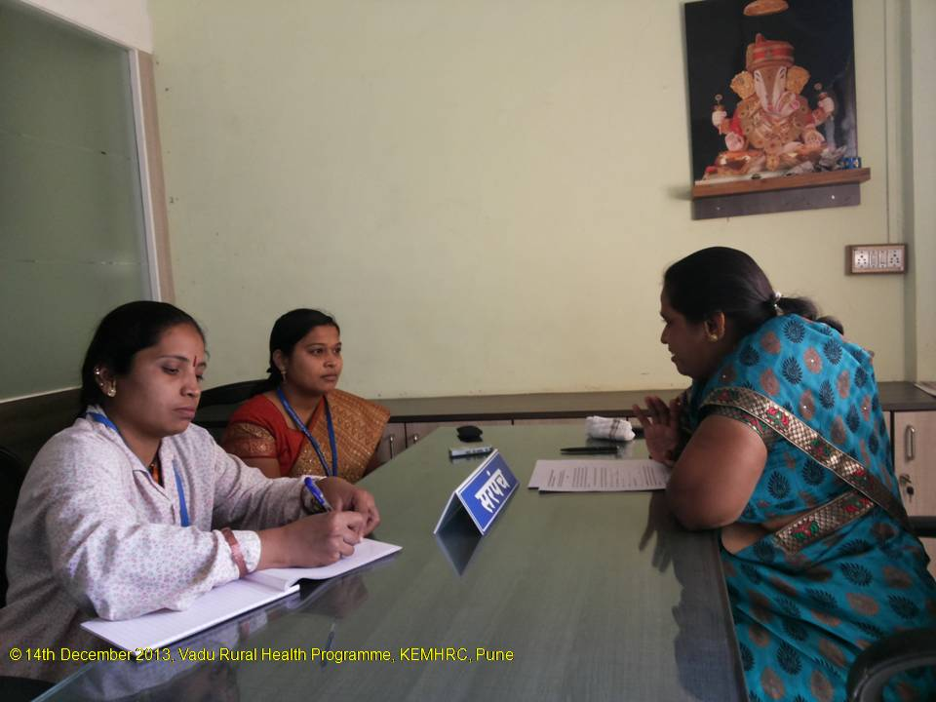
Thank You

